Slide 1
Intermediate Analytics ALY6015 Lecture 1: Descriptive Statistics and Graphical Representations

Slide 2
Welcome! Today’s Agenda
Introductions
Administrative Notes
Syllabus Review
Lecture – Part 1
<BREAK>
Lecture – Part 2
Assignment #1 Overview
Notes:
.

Slide 3













Introductions: Thomas Hamnett
WHERE I’VE STUDIED
WHERE I’VE WORKED
WHERE I’VE LIVED
WHAT I DO FOR FUN

Slide 4
Introductions: Class
Name
Background (undergraduate major, work experience, etc.)
Experience with analytics so far
What do you hope to achieve in this class?
One fun fact!

Slide 5
Administrative Notes
Class time is 6:15pm – 8:25pm
Please bring computers to every class session, as we will conduct live sessions with R and R Studio
Classroom participation is crucial to learning – I will cold call on students who do not participate in class discussion
Refer to syllabus for grading and assignment dates – while I intend current syllabus to be final, there may be changes to dates of assignments or other modifications during the semester (I make an announcement and will publish a new syllabus version if so)

Slide 6
Syllabus Review

Slide 7
How Did We Get Here?
ALY6000: Introduction to Analytics
“What is analytics?”
Overview of the history, theory, ethical considerations, and industry applications of analytics
ALY6010: Probability Theory and Introductory Statistics
“What are the mathematical foundations of analytics?”
Introduction to the field of statistics and probability
ALY6015: Intermediate Analytics
“How do I conduct analytics projects?”
Leverage programmatic environments to apply analytics to data (focus on R programming language)
Develop complete analytics projects – describe data, make inferences, leverage different modeling techniques, manipulate data sets, forecast future performance based on historical data, visualize results, and synthesize analysis to develop and deliver conclusions

Slide 8
Topics Covered in this Course
Descriptive statistics in R (TODAY)
Graphical representation of data in R (TODAY)
Inferential statistics in R (Week 2)
Hypothesis testing (Week 2)
Regression Analysis (Week 2)
Regularization and Lasso Modeling (Week 3)
Data Mining (Week 4)
Clustering and Classification (Week 4)
Time Series Forecasting (Week 5)
Bringing it all together – Group Project (Week 6)

Slide 9
Lecture Part 1 Descriptive Statistics in R

Slide 10
Descriptive vs. Inferential Statistics
Type
Description
Week 1 Focus
Descriptive Statistics
Collecting, organizing, summarizing, and presenting data – including calculating various properties of the data and graphing those properties
Inferential Statistics
Applying statistical models to sample data to make inferences, calculate confidence intervals, and make predictions – including hypothesis testing and regression

Slide 11
Descriptive Statistics
Category
Use
Statistics
Measures of Central Tendency
“What are the averages in my data?”
Mean
Median
Mode
Measures of Variability
“How are my data distributed?”
Variance
Standard Deviation
Range
Quartiles
Skewness
Kurtosis

Slide 12
Measures of central tendency
Mode – the score value with the highest frequency
Median – the point below which 50% of the cases fall
Mean = average

Slide 13
Measures of Variability
Range
Variance
Standard deviation=square root of the variance
Notes:
The variance should be the average squared deviation of scores from the mean. Our interest is in talking about populations. For the populations dividing the sum of squared deviations by the number of cases produces a biased estimate therefore the denominator is N-1 rather than N. We use the same for the sample to simplify our transition from descriptive to inferential statistics (sample to population).

Slide 14
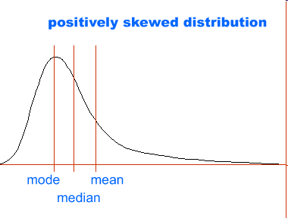
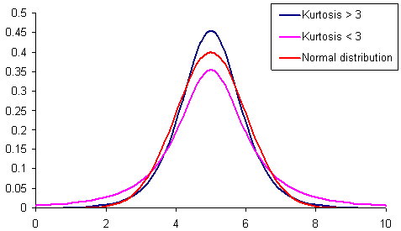
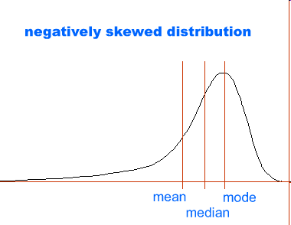
Relationships among measures of central tendency
Kurtosis Examples
Notes:
By comparison, the positively and negatively skewed distributions are not symmetrical.
For positively skewed distributions the median is lower than the mean.
The reverse is true for negatively skewed distributions.

Slide 15
Descriptive Statistics in R
We will explore the mtcars data in the datasets package of R
Find out about the mtcars dataset by using the help() command
We will explore descriptive statistics using the mtcars dataset

Slide 16
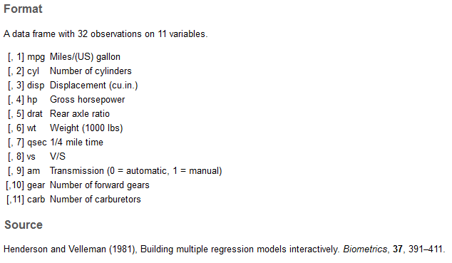
mtcars Dataset

Slide 17
Descriptive Statistics Calculations
Exploratory: head()
Selecting individual fields: $
Measures of central tendency: Mean, Median, Mode
Measure of variability: Variance, Standard Deviation, Range, Quartiles
What does the summary function do?
Which fields are best for this analysis?
How about subsetting (see: which)? Grouping (see: tapply)?
Enrichment (will be very helpful in later classes) – the dplyr package

Slide 18
Break!

Slide 19
Lecture Part 2 Graphical Representation of Data in R

Slide 20
mtcars Dataset Visualized
What might we want to visualize?
How might we want to visualize descriptive statistics?

Slide 21
Visualizations
Histogram
Add context? (see: points, rug)
Boxplot
Adding the normal curve (see: curve)
Check for normal distribution (see: qq)
Scatter plots
Stem and leaf plots
Enrichment: qplot and ggplot2 packages (more advanced visualizations)

Slide 22
Towards Inferential Statistics: Z-Score
z-scores – how many standard deviations above or below the mean a particular score lies

Slide 23
Week 1 Assignment
View assignments as opportunities to practice newly learned materials. I look for effort and hard work. I have no particular expectations of word count or page limits. Show me that you put in required effort.
For the following assignment, please submit your R code, the output, graphs and figures (if any), and your interpretation in a document that has your name, course information, instructor name, and the assignment number.
1. Use one of R’s datasets (iris, trees, rivers, etc.) or your own dataset for this task. Using descriptive statistics, visualize this data numerically and graphically. You can use the following resource as a guide: section 2.5 (p. 15) and 3.5 (p.25) from “Using R for Data Analysis and Graphics ”. Make sure to look into the a) summary of the data, b) display it in histogram, c) boxplot, d) qqnorm and e) other plots and functions. Interpret your findings in words. Try to use functions we have not covered in class but you learned about from the reading and video materials of this Week.
2. According to CDCP, in 2010 the average height of adult women/men in the USA was 63.8 inches, with the standard deviation of 2.7 inches. Calculate the standardized height (z-score) of a U.S. woman who is 71 inches tall. Feel free to find the data for adult women/men in the country of your choice and calculate their standardized height. Explain what the findings mean. Submit your R code, the result, and your interpretation.
3. Using height_weight_byGender.csv data file (link on Blackboard), plot a histogram of men’s and women’s height (or weight) distributions and overlay them so you can see both distributions at the same time. Submit your R code, your figure, and your interpretation.
4. Using R, generate z score data. Using that data, calculate SD. Submit your R code, your output, and your interpretation.
Please let me know if you are unable to download the datafile or have any other question/concern.

Slide 24
Practical Tips
#add comments
How to find datasets: see library(help=“datasets”)
How to load data: see read.csv()
How to check current directory / change directory
getwd()
dir()
setwd()
(‘..’) to move up
How to save charts: see dev.copy() function, make sure to use dev.off() after publishing your plot
How to install packages
Generate z-scores: see scale() function
*Important* You must add interpretation to your results – only writing code supporting your analysis is not sufficient
I use TurnItIn – code copied from internet sources *will* be detected (please write your own original code)

Slide 25
Questions

